Slide 1
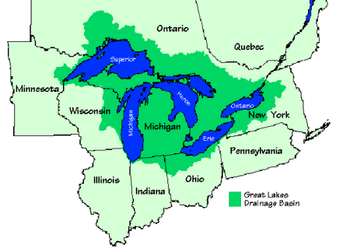
The Great Lakes Region
Michigan is made
Up of an Upper and
Lower Peninsula
There are 5 Great Lakes
Huron
Ontario
Michigan
Erie
Supior
There are 5 states that border Michigan
3 border the land
Ohio, Indiana, Wisconsin
2 border the water
Minnesota, Illinios

