Slide 1
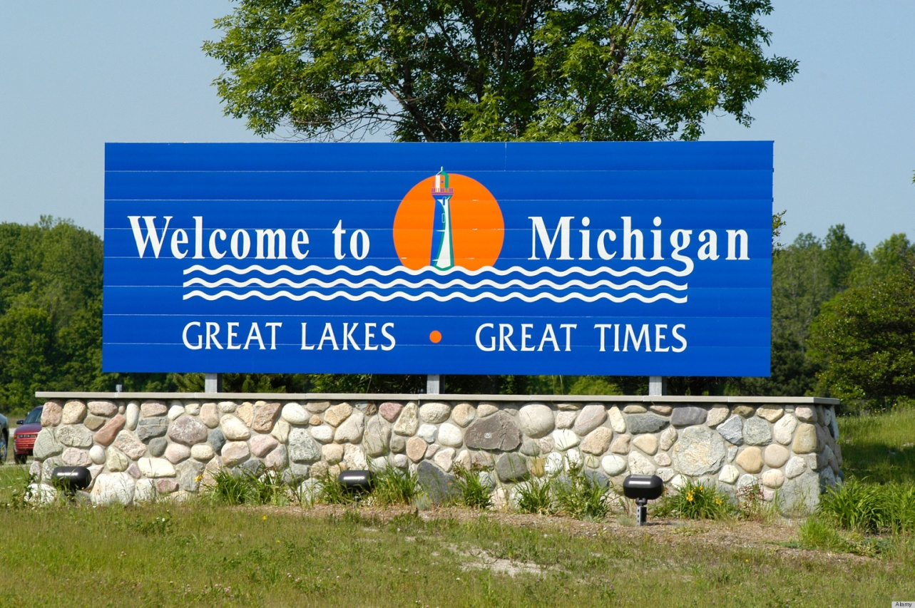
Michigan Geography

Slide 2
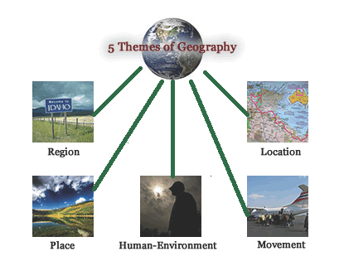
Five Themes of geography
Location
Place
Region
Movement
Human Environment Interaction

Slide 3
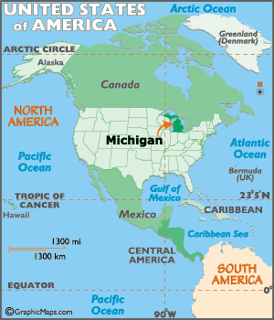
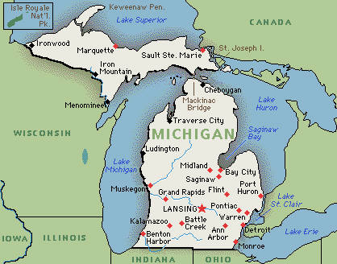
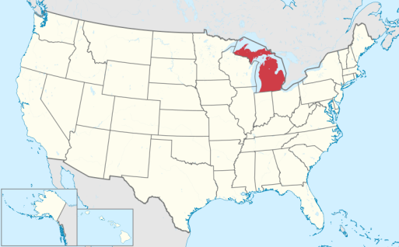
Location
Absolute Location:
  See Map
Relative Location:
  Bordered by Ohio, Indiana, Wisconsin, and Canada.

Slide 4
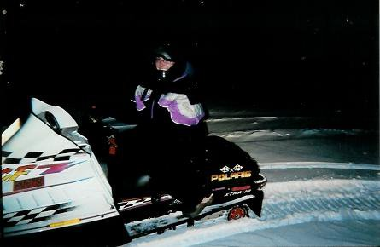
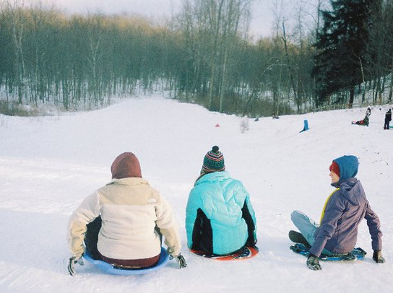
Place
Population: 9.883 million
Language: English, Spanish, Arabic, German, Polish, French
Temperature: 14 – 83 degrees F
Area: 58,513 square miles

Slide 5
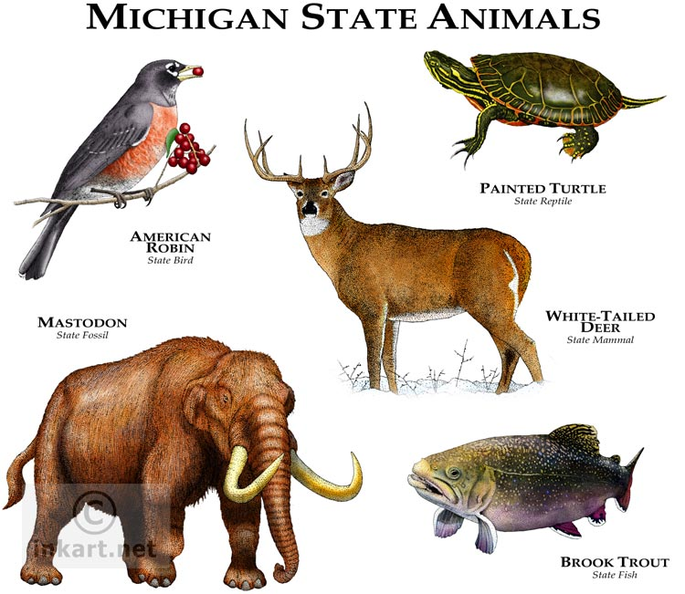
Animals

Slide 6
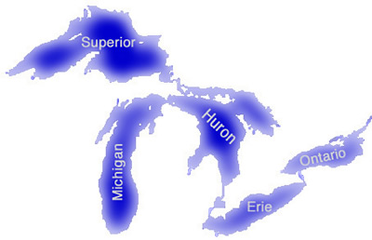
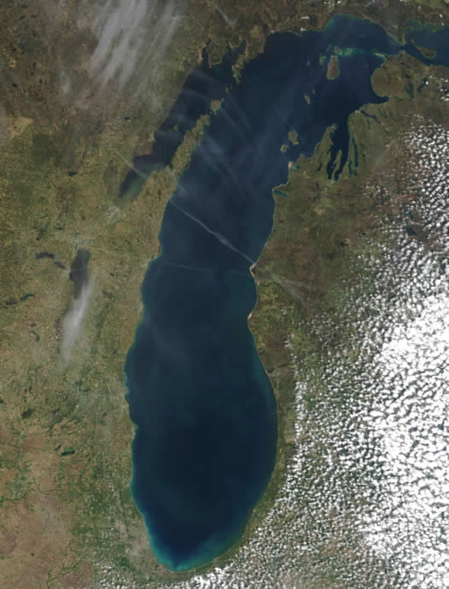
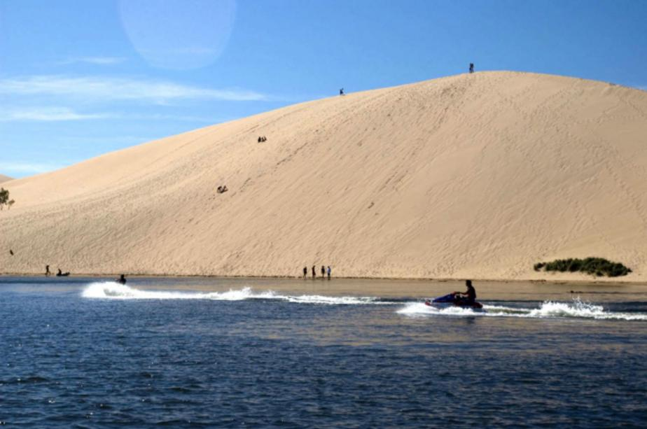
The Great Lakes
Lake Michigan
Huron
Ontario
Michigan
Erie
Superior

Slide 7
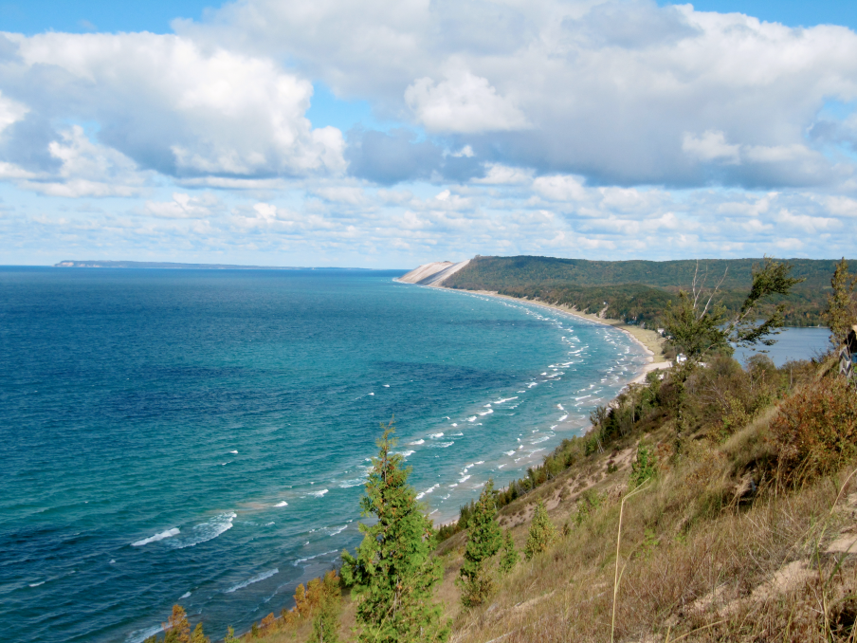
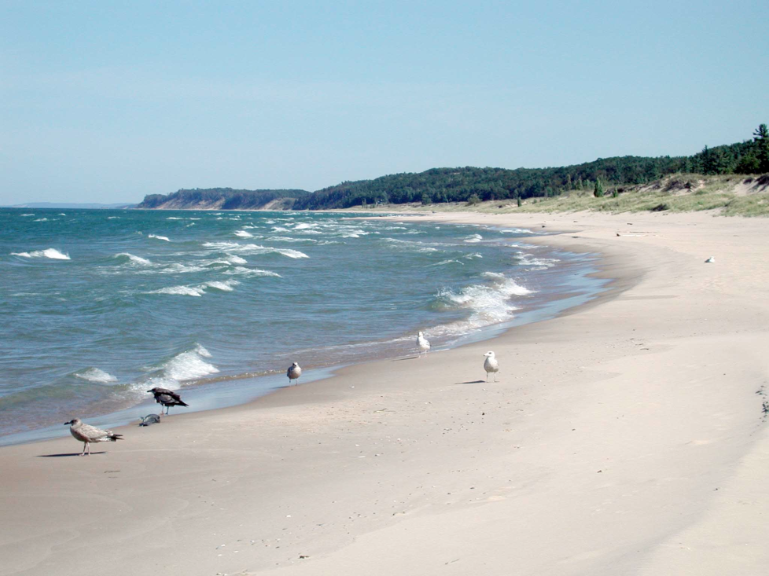
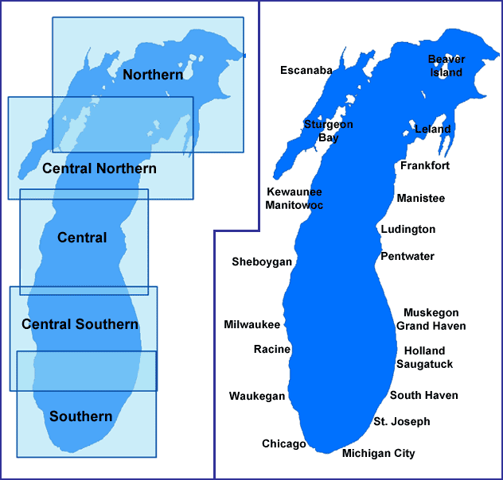
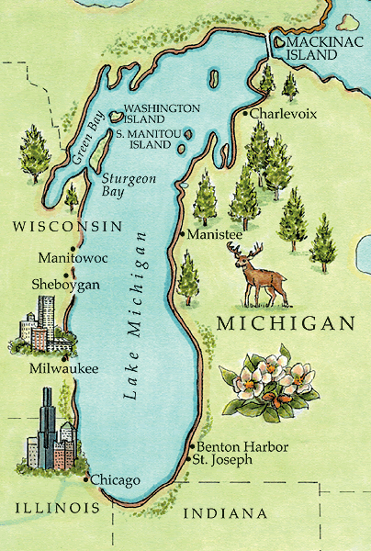
Lake Michigan

Slide 8
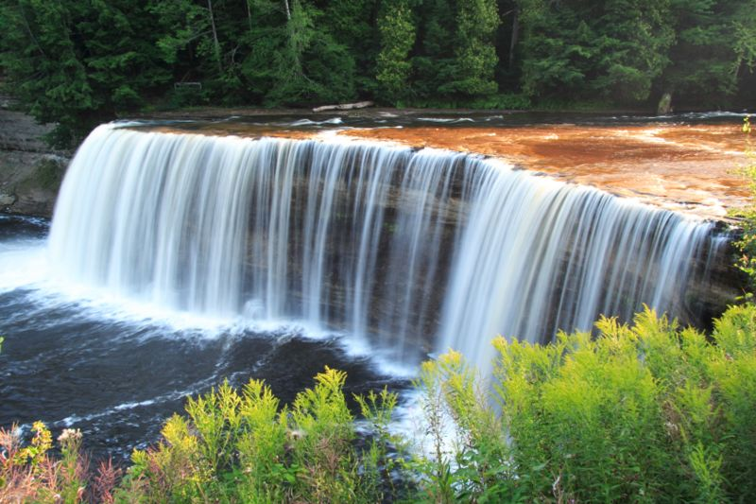
Region
Became a state in 1837
Name Mishigamaa = “large water”
Religion
  79% Christian
  17% Unaffiliated
Ethnicity
  79% White
  14% African American
  2.4% Asian
Ancestry
  22% German
  12% Irish
  10% English

