Slide 1
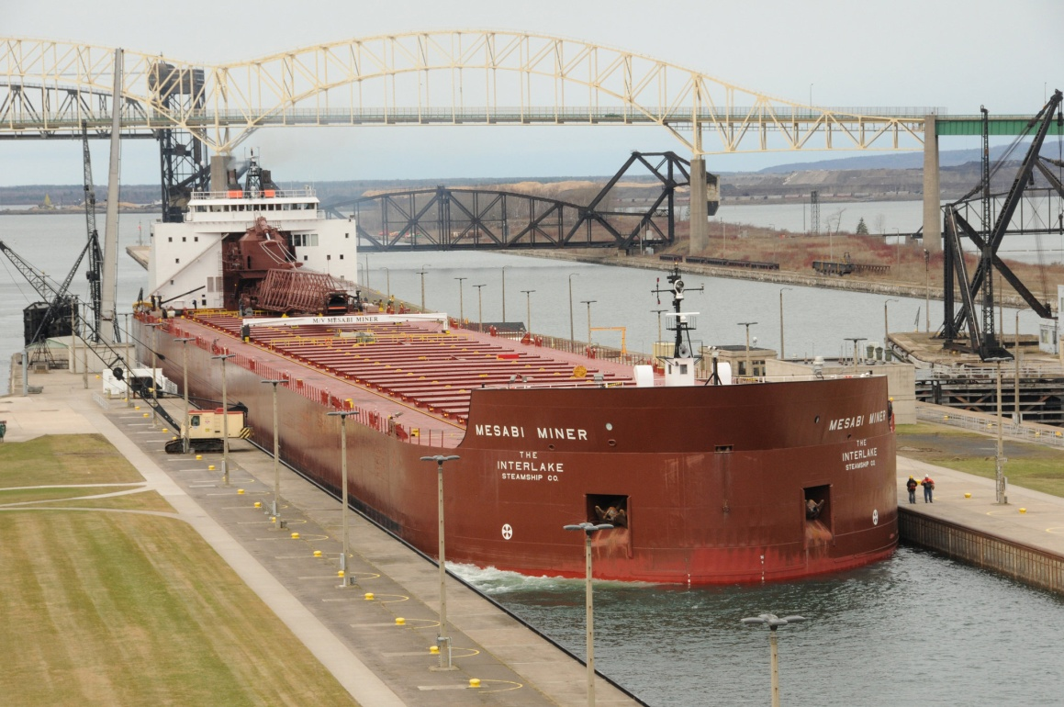
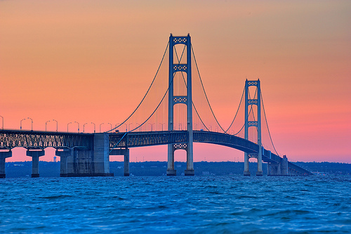
Movement
Cars are very important!
Trains
Boats
Bridges

Slide 2
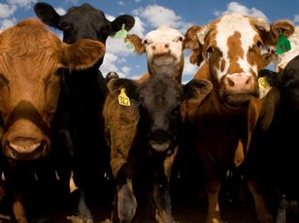
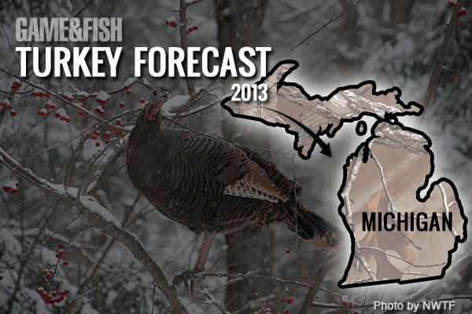
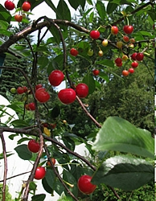
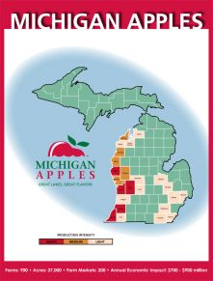
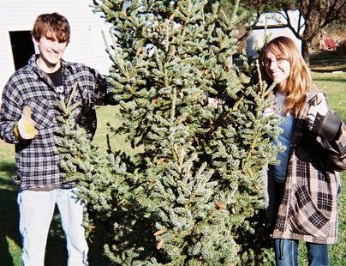
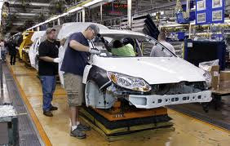
Human Environment Interaction
Goods
Livestock (cattle, chicken, turkey, dairy)
Crops (corn, Christmas trees, apples, cherries)
Cars

Slide 3
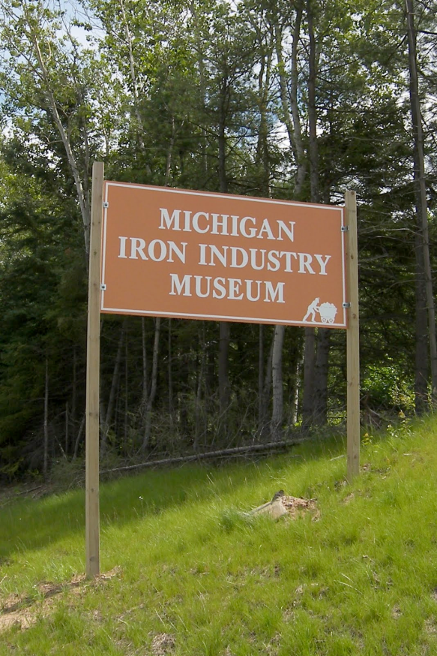
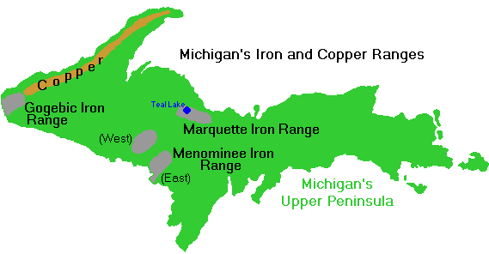
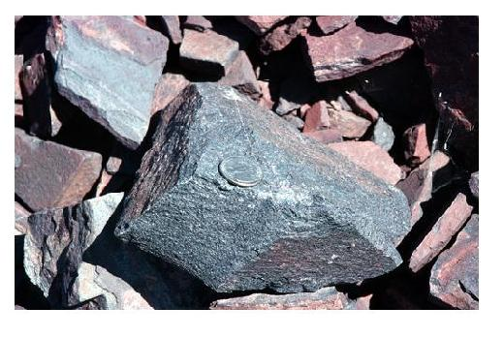
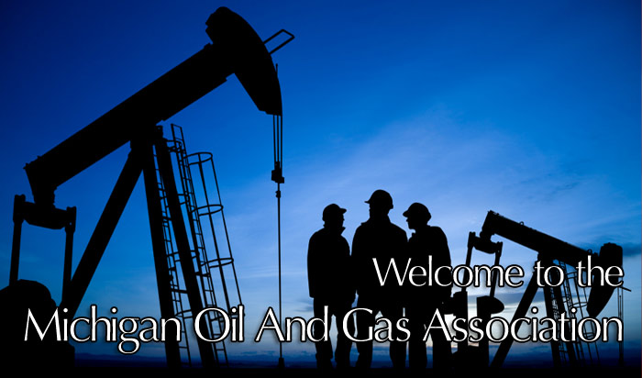
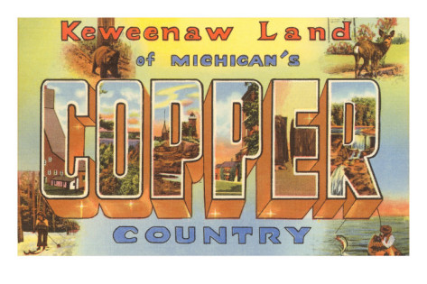
Natural Resources
Natural gas, iron ore, petroleum, copper
Services
Heath care, engineering, finance

Slide 4
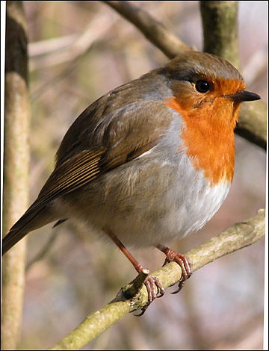
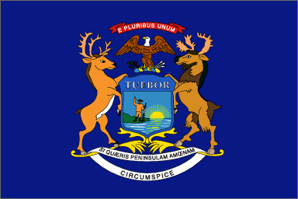
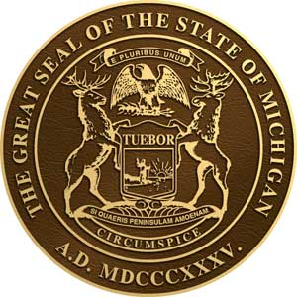
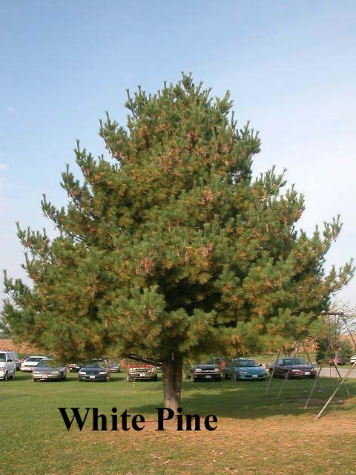
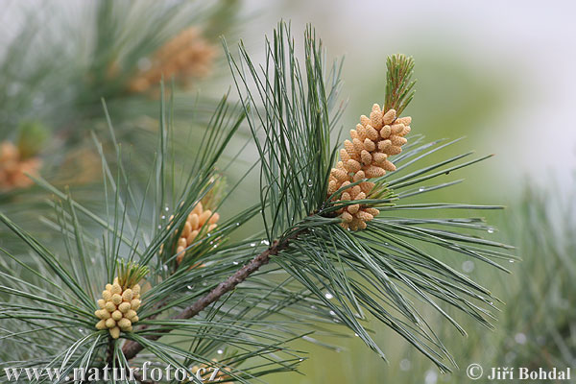
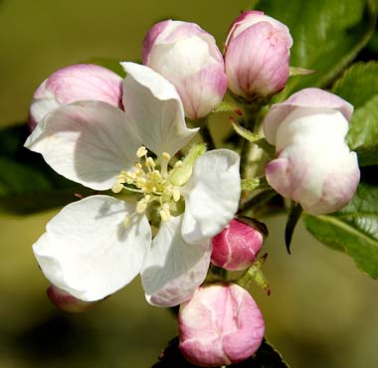
The State of Michigan
State Flag
Robin
State Seal
Eastern white pine
Apple Blossom Pyrus coronaria

Slide 5
Universities
University of Michigan
Michigan State University
Wayne State University
Central Michigan University
Grand Valley State University
Western Michigan University
Eastern Michigan University

Slide 6
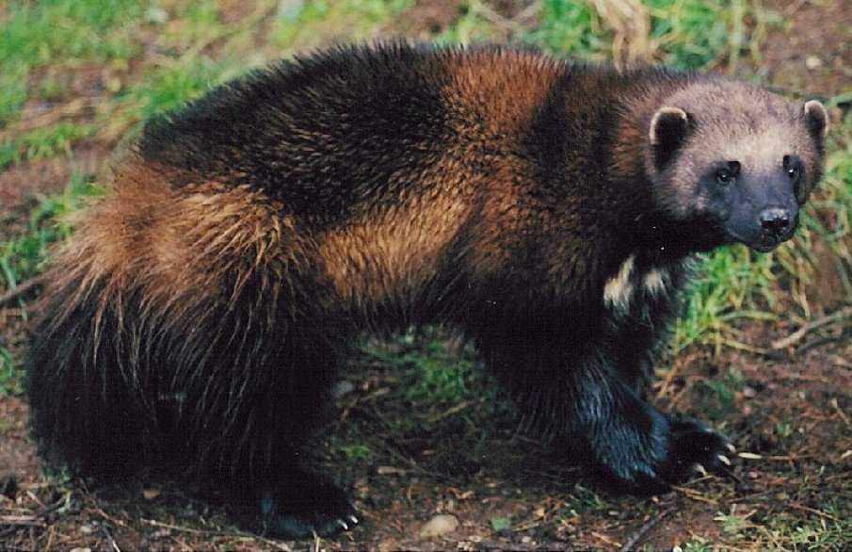
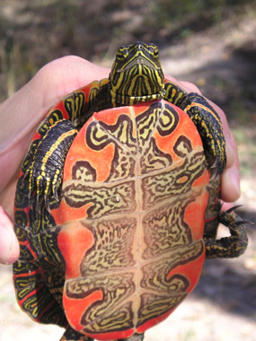
Fun Facts
Although Michigan is often called the "Wolverine State" there are no longer any wolverines in Michigan.
Detroit is known as the car capital of the world.
The painted turtle is Michigan's state reptile.
The western shore of Michigan has many sand dunes. The Sleeping Bear Dunes rise 460 feet above Lake Michigan. Living among the dunes is the dwarf lake iris the official state wildflower.
Michigan has the longest freshwater shoreline in the world.
The Detroit Zoo was the first zoo in America to feature cageless, open-exhibits that allowed the animals more freedom to roam.
Michigan has more than 11,000 inland lakes and more than 36,000 miles of streams.
Michigan has 116 lighthouses and navigational lights.
Isle Royal Park shelters one of the largest moose herds remaining in the United States.
Standing anywhere in the state a person is within 85 miles of one of the Great Lakes.
Michigan has 116 lighthouses and navigational lights.

Slide 7
Video Clips
http://www.youtube.com/watch?v=JcBkJEOnJi0
http://www.youtube.com/watch?v=WgsR6lR2Pr0

Slide 8
How the great lakes came to be
View the Great Lakes video link below:
https://youtu.be/ibTWQogsbL8

